Slide 1
Understanding and Preprocessing Quantitative Data with Large Language Models
Varun Sayapaneni
David Rankin

Slide 2
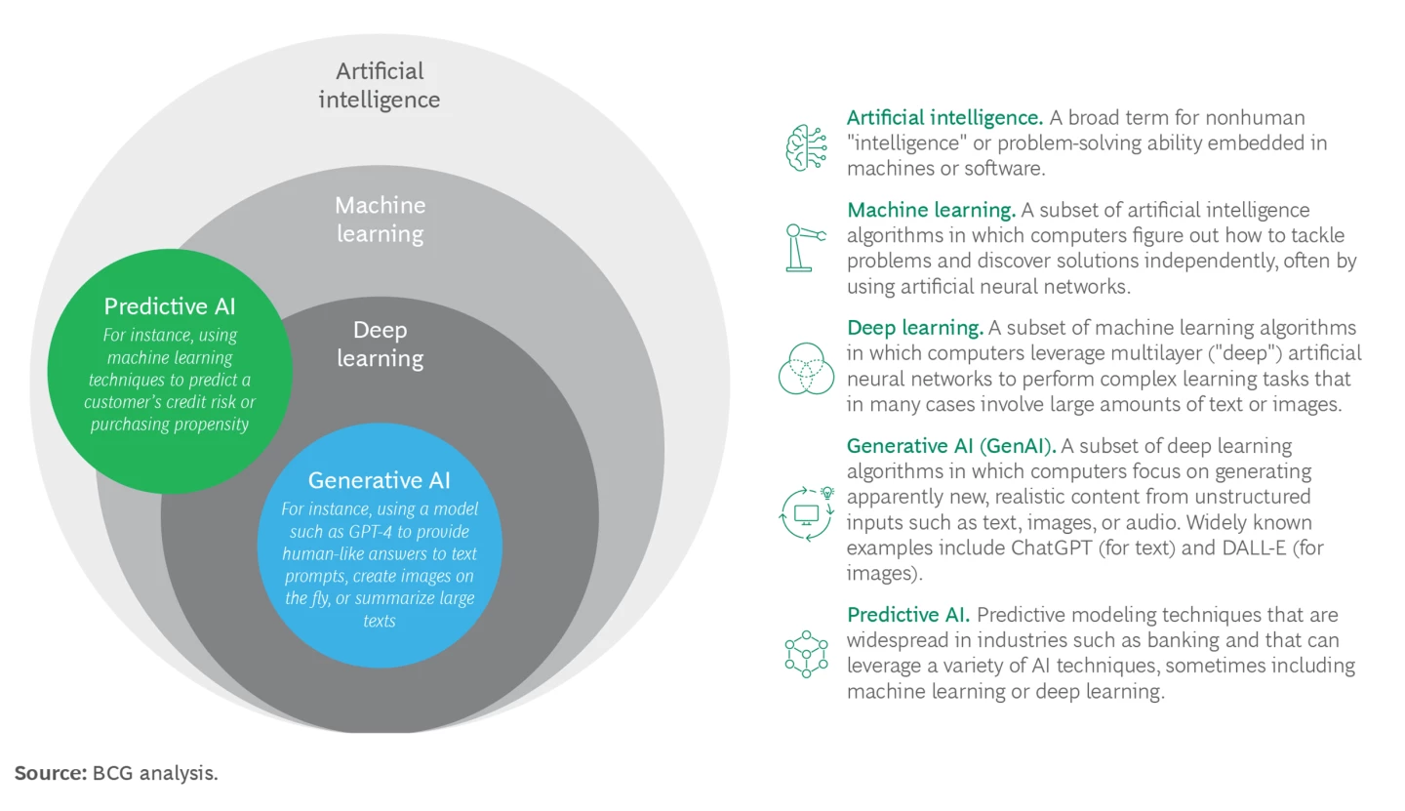
What is Artificial Intelligence
Notes:
Source- https://www.bcg.com/publications/2023/a-genai-roadmap-for-fis
Machine Learning is the general term for when computers learn from data.
Neural networks are inspired by the structure and function of the human brain, allowing for automatic feature extraction and representation learning.

Slide 3
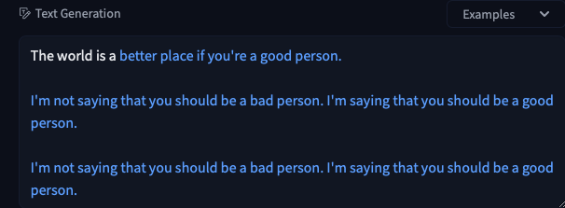
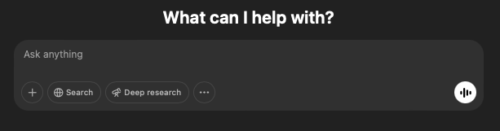
What is Generative AI
GPT-2 Text Completion
GPT-4o Conversational Assistant
Notes:
GPT stands for "generative pre-trained transformer"

Slide 4

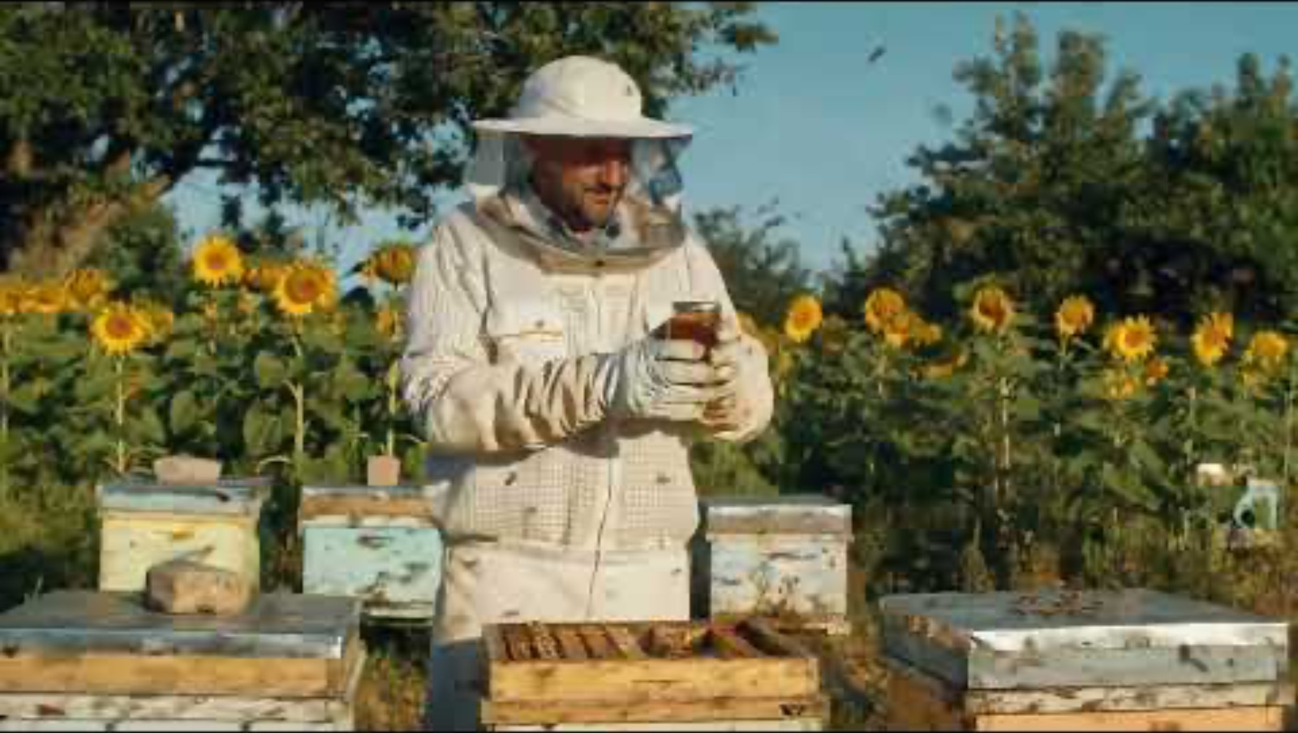
Generative AI Examples
Notes:
Check the following information:
Check the downloads for photo realistic images https://www.boredpanda.com/digital-art-ai-artificial-intelligence-historical-figures-modern-times/
https://prompthero.com (for more images or prompts)

Slide 5
How to interact with LLMs
APIs - Requires programming
Chat interfaces - Web UI interaction
Command-line interface (CLI) tools – ollama, cURL or Docker

Slide 6
LLMs are good at
Extracting information
Interpreting user instructions
Generating synthetic data
Creative tasks
Assisting with Data
Coding & Debugging

Slide 7
LLMs are bad at
Understanding the objectives with little to no context
Handling large datasets efficiently
Guaranteeing factual accuracy
Logical or easy questions (for humans)
Complex statistical or mathematical computations*
Notes:
What is a large dataset?
My context window is currently around 4,096 to 8,192 tokens (which roughly translates to 3,000–6,000 words in English).If the input exceeds this limit, older parts of the text get truncated, leading to loss of context.
What to Do for Large Data?
Chunking: Split data into meaningful parts before processing.
Embedding & Retrieval: Store large text as embeddings and fetch only relevant parts.
Fine-tuning: Train the model on structured data to avoid hallucination.

Slide 8
LLMs and Data
Discussing the various types of data
Gathering or generating data
Understanding the data
Data Cleaning and Transformation
Data Analytics and Visualizations
Notes:
What is a large dataset?
My context window is currently around 4,096 to 8,192 tokens (which roughly translates to 3,000–6,000 words in English).If the input exceeds this limit, older parts of the text get truncated, leading to loss of context.
What to Do for Large Data?
Chunking: Split data into meaningful parts before processing.
Embedding & Retrieval: Store large text as embeddings and fetch only relevant parts.
Fine-tuning: Train the model on structured data to avoid hallucination.

Slide 9
Types of Data
Qualitative vs Quantitative
Structured vs Unstructured

Slide 10
Gathering Data
Generate synthetic data with LLMs
Find or gather real datasets via websearch

Slide 11
Understanding the Dataset
Getting the overview of the dataset
Accessing the data quality
Asking for advice
Descriptive stats
Modifying the Data

Slide 12
Data Cleaning & Transformation
Handling missing values
Handling outliers
Fixing inconsistencies
Outputting in various formats

Slide 13
Pros and Cons with respect to Data
Pros
Natural Language Interaction
Quick insights and explanations
Brainstorming and problem-solving
No coding required

Slide 14
Pros and Cons with respect to Data
Cons
Hallucinations
Limited assistance when dealing with larger datasets
Data Privacy
Environmental concerns
Notes:
https://ml.energy/leaderboard/?__theme=light

Slide 15
How to deal with the challenges
Asking for sources
Coding or generating scripts
Using models locally or enable the data privacy option
Using specialized tools with AI Integration
Notes:
Need examples for the last point

Slide 16
Conclusion
Next session on the workshop series
Consultations, Office Hours – Contact Digital Scholarship and Data Services

Slide 17
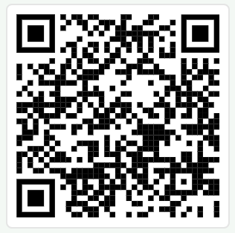
Survey
https://ou.libwizard.com/f/datasurvey

